Slide 1
Setting up JPA into Eclipse from scratch & performing CRUD operation
Priyanka Sarode

Slide 2
Index
Object Persistence
ORM and its need
JPA and its need
Java Persistence API
Working with JPA
Persistence.xml
Managed entities with Entity, EntityManager, EntityManagerFactory
Entity Life Cycle
JPQL

Slide 3
What is Object Persistence?
Object persistence is where an object "persists" over space and/or time. An object that retains its state when it is saved to disk, and loaded from another location, or at a future time, is an object that exhibits the property of persistence.
For a computer gaming system, a gaming world can retain its state through a 'save_game'.
We can save the game, and load it at a future point in time. The characters, locations, and physical objects remain.
Most older computer games used a special file structure, that required special code to store and retrieve a gaming world.
Using object persistence, we can write a game to a file, or read it from a file, with a few lines of code - no matter how large or complex our gaming world is!

Slide 4
Why use object persistence?
The answer is simple - ease of use.
Why design a special save_game format, write large amounts of code to save and restore games, and then have to modify that code every time we build on the gaming system?
Object-orientated programming makes it easier for the programmer to write quality code that is easily maintainable.
We break our gaming system up into objects, because this makes code easier to understand. Taking this train of thought one step further, since objects in Java can be made persistent very easily, it only makes sense to take advantage of this property.

Slide 5
Object persistence in Java
Persistence means to make application’s data to outlive the applications process.
In Java, the objects to live beyond the scope of the JVM so that the same state is available later.
Class Student{
int rollno;
String name;
}
rollno | name
101 | Kajal
Object-World
Relational-World

Slide 6
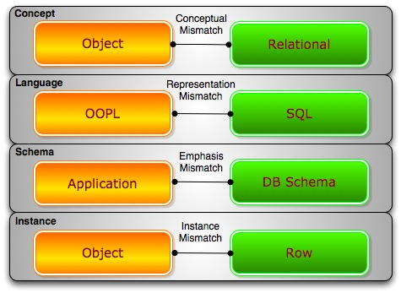
Object Relation Impedance Mismatch
Object-Relational Impedance Mismatch' (sometimes called the 'paradigm mismatch') is just a fancy way of saying that object models and relational models do not work very well together.
RDBMSs represent data in a tabular format whereas object-oriented languages, such as Java, represent it as an interconnected graph of objects.
Loading and storing graphs of objects using a tabular relational database exposes to mismatch problems.
Granularity
Inheritance
Identity

Slide 7
Object Relation Impedance Mismatch
Granularity
Sometimes you will have an object model which has more classes than the number of corresponding tables in the database thus we says the object model is more granular than the relational model.
Class Student{
int rollno;
String name;
Address address;
}
Class Address{
String city;
String area;
}
rollno | name | city | area
101 | Kajal | Nagpur | Pratap Nagar
Relational-World
Object-World

Slide 8
Object Relation Impedance Mismatch
Inheritance (subtypes)
Inheritance is a natural paradigm in object-oriented programming languages. However, RDBMSs do not define anything similar on the whole
Student
Online Learning
College
Student
Online Learning
College
Object-World
Relational-World

Slide 9
Object Relation Impedance Mismatch
Identity
A RDBMS defines exactly one notion of 'sameness': the primary key. Java, however, defines both object identity a==b and object equality a.equals(b).
a==b
a.equals(b)
Student
PK | Rollno
- | Name
Object-World
Relational-World

Slide 10
What is ORM?
To remove the impedance mismatch problem, map the data representation in an object model (Java Types) to relational model(SQL Types) this process is called ORM : Object Relation Mapping.
Storing object-oriented entities in a relational database is often not a simple task and requires a great deal of repetitive code along with conversion between data types.
Object-relational mapper, or O/RM, were created to solve this problem. An O/RM persists entities in and retrieves entities from relational databases without the programmer having to write SQL statements and translate entity properties to statement parameters and result set columns to entity properties.

Slide 11
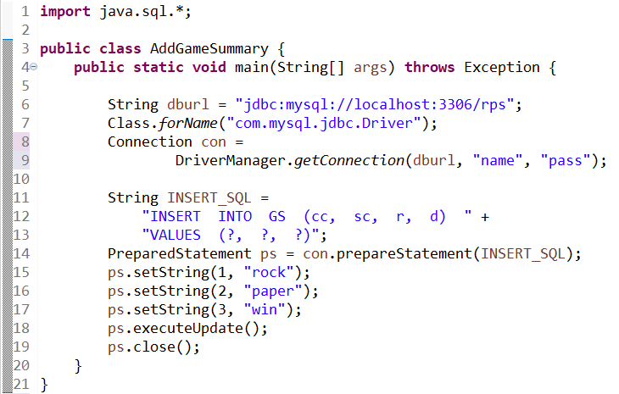
Boilerplate code using JDBC

Slide 12
Object Relation Mapping
An ORM solution consists of the following four entities −
Sr.No. | Solutions
1 | An API to perform basic CRUD operations on objects of persistent classes.
2 | A language or API to specify queries that refer to classes and properties of classes.
3 | A configurable facility for specifying mapping metadata.
4 | A technique to interact with transactional objects to perform dirty checking, lazy association fetching, and other optimization functions.

Slide 13
Java ORM Frameworks
There are several persistent frameworks and ORM options in Java. A persistent framework is an ORM service that stores and retrieves objects into a relational database.
Enterprise JavaBeans Entity Beans
Java Data Objects
Castor
TopLink
Spring DAO
Hibernate
And many more

Slide 14
What is JPA?
JPA : Java Persistence API is a collection of classes and methods to persistently store the vast amount of data into a database.
JPA is only a specification and cannot be used on its own, providing only a set of interfaces that define the standard persistence API, which is implemented by a JPA provider, like Hibernate, EclipseLink, or OpenJPA.
It forms a bridge between object models(Java Program) and relational models (Database).
JPA is the Java standard for mapping Java objects to the relational database.

Slide 15
Why we need JPA?
The main purpose to have JPA is to have persistent objects in the form of JAVA objects which can be used later while interacting with the database.
To reduce the impedance and make the front-end application independent of the backend we use ORMs as a middleware.
JPA facilitates the use of ORMSs thus making the whole process flexible and modular.

Slide 16
Advantages of JPA
It eliminates the use of SQL queries and JDBC connectors thus reducing the complexities of database programming.
Significantly reduces the dependency on the database system one is using at the backend. This is very useful at the time of DBMS migrations saving a lot of energy and effort.
The code looks clean and the developer only needs to know JAVA rather than learning SQL or PL/SQL.

Slide 17
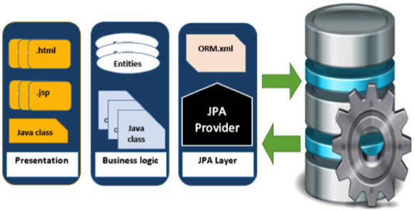
Where to use JPA?
To reduce the burden of writing codes for relational object management, a programmer follows the ‘JPA Provider’ framework, which allows easy interaction with database instance. Here the required framework is taken over by JPA.
JPA is an open source API, therefore various enterprise vendors such as Oracle, Redhat, Eclipse, etc. provide new products by adding the JPA persistence flavor in them. Some of these products include:
Hibernate, Eclipselink, Toplink, Spring Data JPA, etc.

Slide 18
Class level Architecture
Java Persistence API is a source to store business entities as relational entities. It shows how to define a PLAIN OLD JAVA OBJECT (POJO) as an entity and how to manage entities with relations.
As shown in figure classes and interfaces are used for storing entities into a database as a record.
They help programmers by reducing their efforts to write codes for storing data into a database.
It works with XML descriptors and annotations.

Slide 19
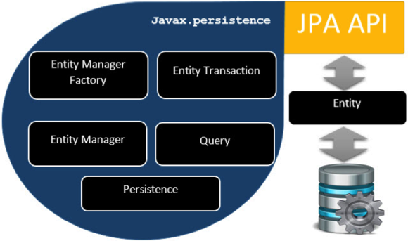
Class level Architecture

Slide 20
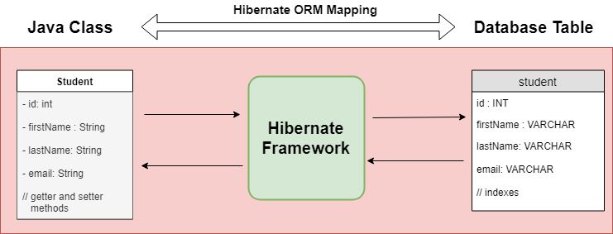
What is JPA Entity?
Entities in JPA are nothing but POJOs representing data that can be persisted to the database. An entity represents a table stored in a database. Every instance of an entity represents a row in the table.
@Entity - JPA Annotation : Creating the JPA Entity Class(Persistent class)

Slide 21
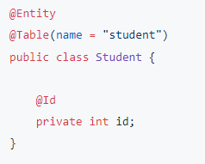
What is JPA Entity?
Here we are using @Entity, @Id, @GeneratedValue and @Column annotations for mapping between Java object to database table columns.
@Table :This annotation specifies the table in the database with which this entity is mapped.
@Id : This annotation specifies the primary key of the entity.
Each JPA entity must have a primary key that
uniquely identifies it.
@GeneratedValue : to generate the identifiers
the value can be AUTO, TABLE, SEQUENCE,
or IDENTITY.
@Column : Specifies the mapped column
for a persistent property or field.

Slide 22
JPA Overview
EntityManagerFactory — This is a factory class of EntityManager. It creates and manages multiple EntityManager instances.
EntityManager — It is an interface; it manages the persistence operations on objects. It works like a factory for Query instance.
Entity — Entities are the persistence objects, stored as records in the database.
EntityTransaction — It has one-to-one relationship with EntityManager. For each EntityManager, operations are maintained by the EntityTransaction class.
Persistence — This class contains static methods to obtain the EntityManagerFactory instance.
Query - This interface is implemented by each JPA vendor to obtain relational objects that meet the criteria.

Slide 23
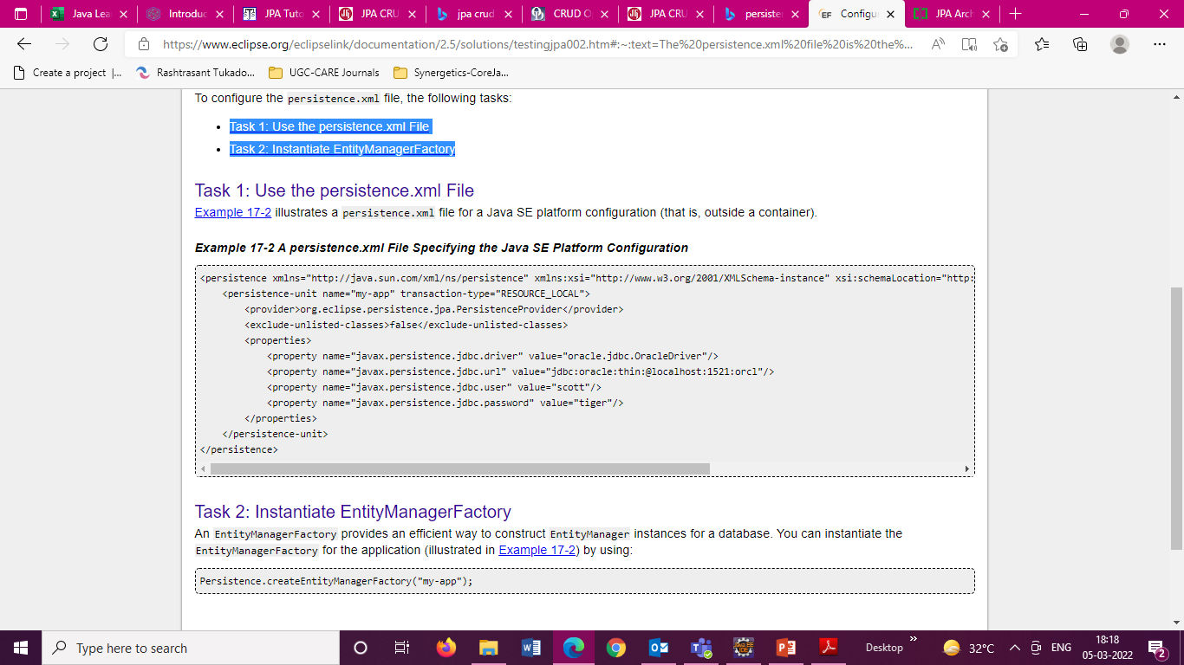
Persistence Configuration
The persistence.xml file is the deployment descriptor file for persistence using JPA. It specifies the persistence units and declares the managed persistence classes, the object/relation mapping, and the database connection details.

Slide 24
Persistence Configuration
The persistence.xml file defines one or more persistence units, and you can configure things like:
the name of each persistence unit,
which managed persistence classes are part of a persistence unit,
how these classes shall be mapped to database tables,
the persistence provider that shall be used at runtime,
the data source you want to use to connect to your database

Slide 25
Entity Manager
Entity Manager is an interface to perform main actual database interactions.
Creates persistence instance.
Removes persistence instance.
Finds entities by entity’s primary key.
Allows queries to be run on entities.
Persistence Context : A persistence context handles a set of entities which hold data to be persisted in some persistence store (e.g. database).
Each EntityManager instance is associated with a PersistenceContext.

Slide 26
Entity Manager Methods
Persist() – Make an instance managed and persistent.
merge() – Merge the state of the given entity into the current persistence context.
remove() – Remove the entity instance.
find() – Find by primary key. Search for an entity of the specified class and primary key. If the entity instance is contained in the persistence context, it is returned from there.
getReference() – returns and instance which is lazily fetched and will throw EntityNotFoundException when the instance is accessed for the first time.
flush() – Synchronizes the persistence context with the database.
close(): Flush entity instances first, clears persistence context and nullify the entity manager

Slide 27
Entity Transaction
While managing instances of entities using EntityManager like saving, updating or removing, it is very much required to work in transaction. Therefore you need work with
EntityTransaction getTransaction() : which returns resource-level EntityTransaction which can be used to begin, commit or rollback transactions.
An EntityTransaction not made for read-only operations. For example, finding entity with EntityManager.find() method.

Slide 28
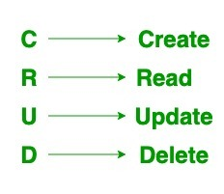
JPA CRUD Operations
Create, Retrieve (Read), Update and Delete operations on an Entity. From the Java program, we can perform these operations on your Entity. The EntityManager represents a JPA link to the relational database which can be used to perform CRUD operations on the Entity objects.
In JPA the EntityManager is an interface which is associated with a persistence context. It is used to interact with the persistence context. Here are a few important methods of EntityManager which is used to perform the CRUD operations.

Slide 29
JPA CRUD Operations
persist(Object entity): This method is used to persist a managed Entity.
remove(Object entity): This method is used to remove an Entity from the persistence context.
merge(T entity): This method is used to save the current state of Entity to the persistence context.
find(Class entityClass, Object primaryKey): This method is used to load an Entity based on its primary key.

Slide 30
Inheritance
Inheritance is a key feature of object-oriented programming language in which a child class can acquire the properties of its parent class. This feature enhances reusability of the code.
The relational database doesn't support the mechanism of inheritance. So, Java Persistence API (JPA) is used to map the key features of inheritance in relational database model.
JPA provides three strategies through which we can easily persist inheritance in database.
Single table strategy
Joined strategy
Table-per-class strategy

Slide 31
SINGLE_TABLE
In this strategy, all the classes in a hierarchy are mapped to a single table.
The annotation @Inheritance is used on the root entity class with strategy =
InheritanceType.SINGLE_TABLE.
@DiscriminatorColumn is used on the root entity class to specify the discriminator column attributes. Discriminator is a way to differentiate rows belonging to different classes in the hierarchy.
@DiscriminatorValue is used on each persistable concrete class to specify a unique discriminator value.
@Entity and other meta-data annotations are used on the root and subclasses as usual.
@Id field should only be defined in the root class.
The root class can be abstract or a concrete class. An abstract entity differs from a concrete entity only in that it cannot be directly instantiated.
This is the default inheritance strategy. That means if we don't specify the strategy attribute of @Inheritance annotation on the the root class or don't use this annotation at all , then InheritanceType.SINGLE_TABLE strategy is assumed.
This strategy has the disadvantage of having rows with null column values for which the entity has no corresponding fields.

Slide 32
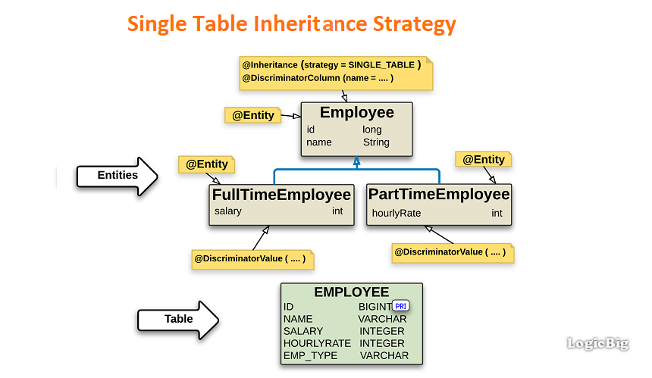
Inheritance

Slide 33
Practical Demo
Setting up JPA / Hibernate into Eclipse and Performing CRUD

Slide 34
Thank You

